Slide 1
A crash course in Kedro
kedro.readthedocs.io
Notes:
Welcome
I'm Antony, maintainer of kedro. Tthanks for joining
This is event suitable for east of here. Have another event later on at 5pm suitable for America. Go and get 8 hours of sleep
Feel free to ask quick questions on chat but for bigger things go to Slido (anonymous, no need to sign up) - even if no question yourself, vote for others. Assisted by Sajid

Slide 2





Agenda & Speaker
📸 Setting the scene
🧐 What is Kedro?
🗺 Where does it fit in?
👩‍🎓 A worked example
😴 Short break
👷‍♀️ Live coding tutorial
👂Q&A
23rd February 2022
@datajoely on , and
Joel Schwarzmann Product @ QuantumBlack
Former Data Engineer
CS background
Kedro user for ~3 years
Notes:
Asdf asdf

Slide 3

Agenda & Speaker
📸 Setting the scene
🧐 What is Kedro?
🗺 Where does it fit in?
👩‍🎓 A worked example
😴 Short break
👷‍♀️ Live coding tutorial
👂Q&A
23rd February 2022
AntonyMilneQB antony.milne
Antony Milne Machine Learning Engineer @ QuantumBlack
Former Theoretical Physicist
Turned Data Scientist
Kedro user for ~2 years, maintainer for ~1 year
Notes:
2 hours total
Will get increasingly technical - if just want to know what kedro is, stay for first bit
Q&A at end
---
Github and discord - main two support channels
Project now owned by Linux Foundation, I still work at QB

Slide 4



We’re hiring across the board
Data Scientist
Technical UX Designer
Data Engineer
Machine Learning Engineer
Product Manager
Product Designer
Software Engineer
APAC
LATAM
EUROPE
NA
Notes:
Recruitment plug
Be like me
Scan QR code or go to social media on left

Slide 5


Insights
Code that no one will use after your project is complete
What are you trying to build?
Notes:
The first question I want to ask is
Let's say you're doing data science to get some insights - might do the job but chances are no one's going to use your code again
This shed does the job as shelter for a night but not robust solution
Probably doesn’t meet building regulations
To make important business decisions or for compliance, need to be stricter
Want a number you can stand behind. Reliable pipeline in production

Slide 6


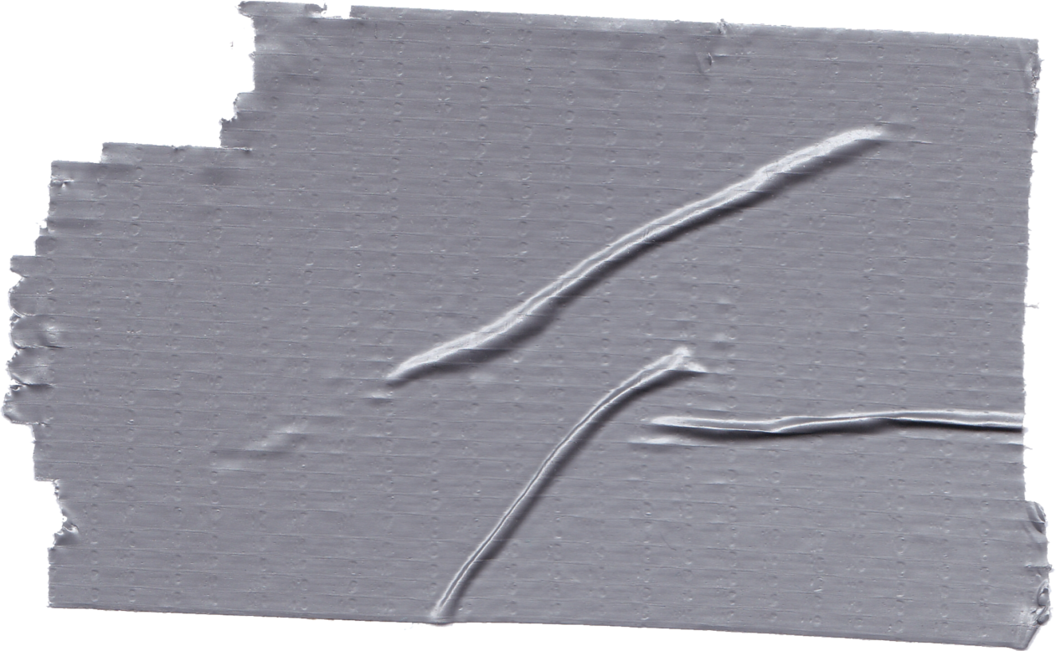
What are you trying to build?
Finding the balance between rapid prototyping and robust software can be hard
Untitled3.ipynb
Meets functional requirements ✔
Notes:
A lot of data science is done in Jupyter notebooks. Can do fancy things in them
This is ok for quick one-off analysis but more not for more sophisticated work
Not a talk against Jupyter notebooks. They are very valuable and have their place.
But something in addition to them which enables BOTH rapid prototyping and development of robust software
This is where kedro comes in

Slide 7
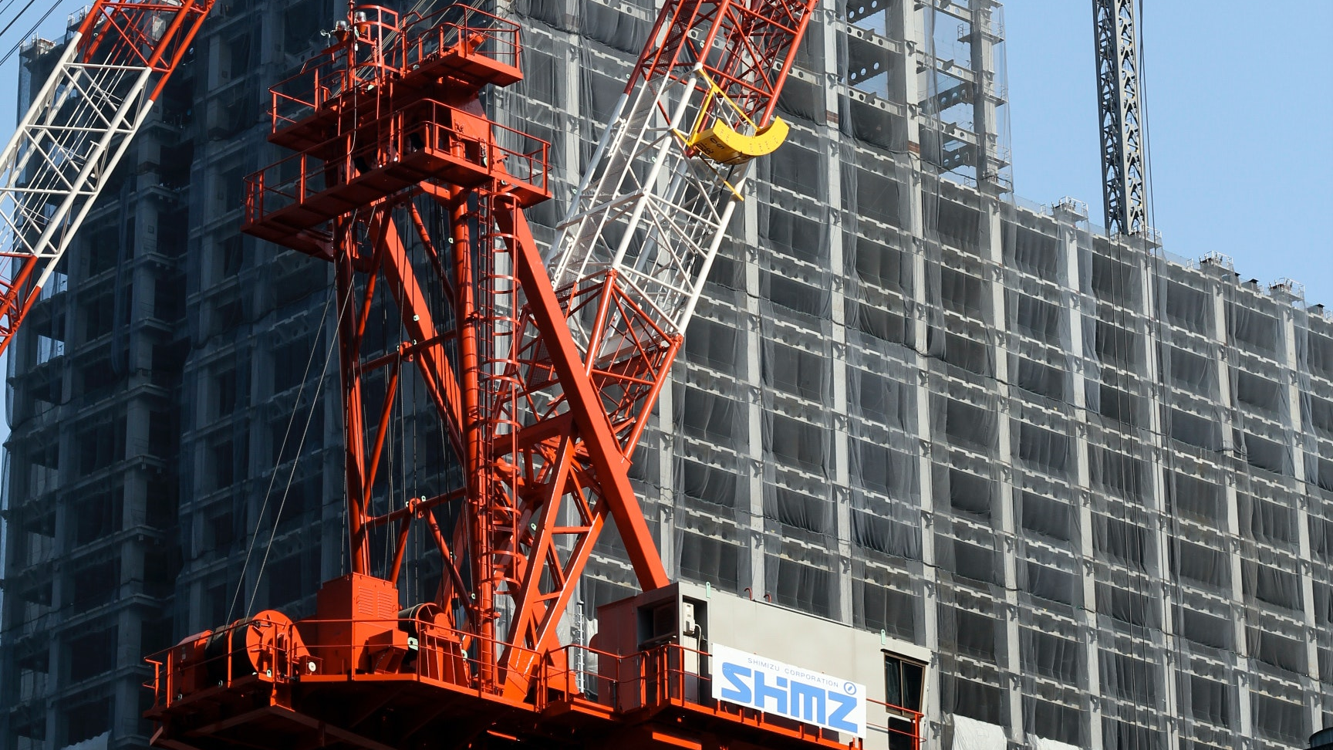
ML Product
Code that needs to be re-run and maintained
What are you trying to build?
Notes:
With kedro, move from building a shack in a field to beautiful skyscrapers
Instead of just one-off insight, build a proper product
Larger scale analysis. Big team needs more structure, version control, ways of working together
Kedro is framework to help with this: reproducible, robust analysis ready for production

Slide 8
The challenges of creating machine learning products
“Data scientists have to learn so many tools to create high-quality code.”
“I have to think about Sphinx, flake8, isort, black, Cookiecutter Data Science, Docker, Python Logging, virtual environments, Pytest, configuration and more .”
“I spend a lot of time trying to understand a codebase that I didn’t write.”
“It’s tedious to always setup documentation and code quality tooling my project.”
“Everyone works in different ways.”
A workflow beyond notebooks still has challenges
“It takes really long to put code in production and we have to rewrite and restructure large parts of it.”
“My code will not run on another person’s machine.”
“No one wants to use the framework I created.”
“We all have different levels of exposure to software engineering best-practice.”
Notes:
Jupyter notebook easy, writing production code is hard
Specifically these are some of the problems kedro tries to solve
Lots of tools, don't necessarily have background in software engineering
Standardisation very important - enables getting to grips quickly with project
Kedro is opinionated, aims to set the standards for you
Wants to make rapid development easy but also robust to be deployed in production

Slide 9




So… what is Kedro?
Kedro is part of Linux Foundation for AI and Data and is maintained by a dedicated product team
What 👩‍🏫
Open-source Python framework created for ML & data practitioners
Follows 12factor App software engineering philosophy encouraging: Modularity, Separation of concerns and Versioning
Why 🧐
Addresses shortcomings of Jupyter Notebook and glue-code with a focus on creating maintainable data science code
You can think of Kedro as ‘React’ or ‘Django’ for ML projects
The ideas built into Kedro come from scar tissue 🤕
Impact on MLOps 🚀
Won Best Technical Tool or Framework for AI in 2019 and the Merit award for the Technical Documentation 2020
Listed on the 2020 ThoughtWorks Technology Radar and the FirstMark 2021 Data & AI Landscape
6,500+ stars on GitHub ⭐️ as of early 2022 Feel free to increase this number…
Notes:
Started at QB, used on many client projects. Open sourced June 2019
Heroku for web apps: 12 factors for apps that are easy to scale
Scar tissue – built by people doing data science projects for many years, real life experience with many clients with variety of tech capabilities
Framework - gives you structure, fill in blanks yourself

Slide 10



















Kedro in the wild
Don’t see your company here? Let us know!
Notes:
Many diverse industries – general framework

Slide 11


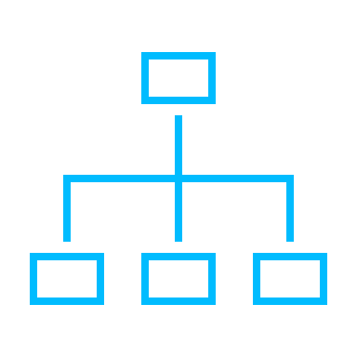







What does Kedro give you?
Project Template
Data Catalog
Nodes + Pipelines
Extensibility
Inspired by Cookiecutter Data Science
Our core declarative IO abstraction layer
Constructs which enable data-centric workflows
Inherit, hook in or plug-in to make Kedro work for you
Ingest Raw Data
Clean & Join Data
Engineer Features
Train & Validate Model
Deploy
Model
Kedro zone of influence
Notes:
Project template: All projects look the same - standardization, know where stuff is
Data Catalog: separation of concerns – config from code. Run environments
Data-centic: DAG. topology of pipeline is dictated by data flow. Not task-centric where data are artifacts
Extensibility: Integration hub. Custom datasets. dvc, dolt, mlflow, neptune
We focus on pipeline development, not how it runs in production (like scheduling). Not an orchestrator - agnostic to deployment method. Docker, Kubernetes, Airflow, Prefect – deployment guides or plugins

Slide 12







Become a Kedroid
Help the community, get swag
The Kedro community is active on: https://discord.gg/7sTm3y5kKu
Official
Support
Documentation is available on Read The Docs: kedro.readthedocs.io/
Source-code and discussions: github.com/kedro-org/kedro/
For feature requests, bug reports and contributions
Notes:
Get swag, if you stay around for a while you can get enough clothes to dress your whole family

Slide 13
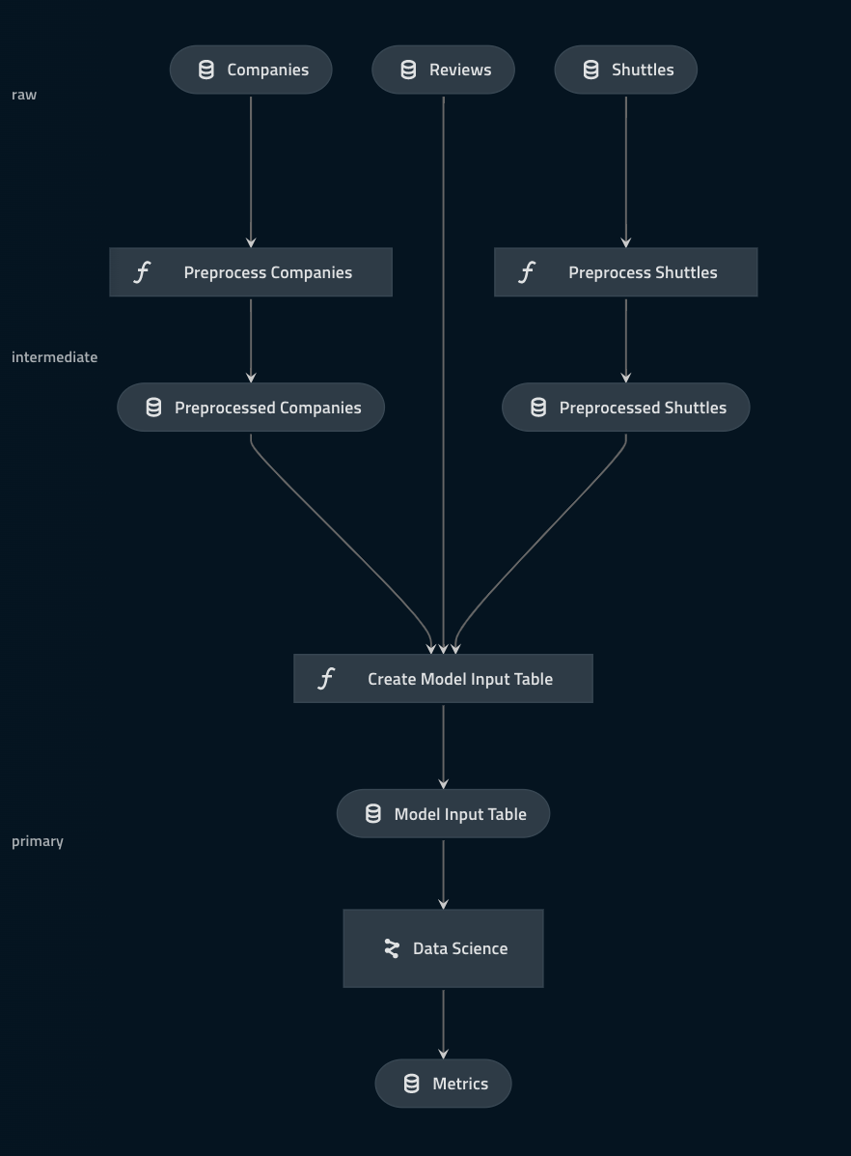
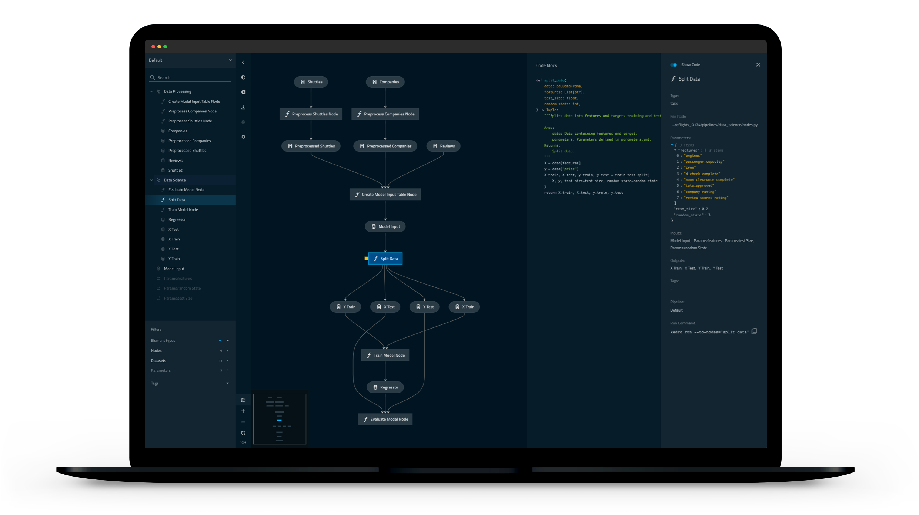
A Kedro worked example
Building our first pipeline
$ kedro viz
See for yourself on demo.kedro.org
Notes:
Pipeline is DAG
Going to go through quickly what's going on, then in more detail at the components
Then in second part will actually write the code for it
Kedro viz use to visualize – great for exploring pipeline, presenting it to non-technical people. More than just pipeline viz but also experiment tracking

Slide 14



A Kedro worked example
Building our first pipeline
Scenario
👩‍🚀 The year is 2160 and the space tourism industry is booming
There are thousands of space shuttle companies taking tourists to the Moon and back 🚀
You have been able to source amenities offered in each space shuttle, customer reviews and company information
Goal
Build a model to estimate the price of a return trip

Slide 15

A Kedro worked example
Building our first pipeline
Raw data sets
Companies
The players in the space travel industry 👩‍🚀
Reviews
Customers reviewing their travel experiences ⭐️
Shuttles
Spacecraft attributes across fleets 🚀

Slide 16

A Kedro worked example
Building our first pipeline
Pre-processing nodes
Nodes are the building blocks of pipelines and represent tasks
These are pure python functions (i.e., no side effects)
Here we clean the raw data ready to be used downstream
Notes:
Pure function just has inputs, transforms them into outputs
Deterministic, repeatable way

Slide 17
A Kedro worked example
Building our first pipeline
Pre-processed data
The typed, cleaned outputs of the pre-processing stage
These combined with the unchanged ‘reviews’ dataset are ready to be merged

Slide 18
A Kedro worked example
Building our first pipeline
Data ready for modelling 👌
Notes:
So have gone from raw data to stuff ready for modelling

Slide 19
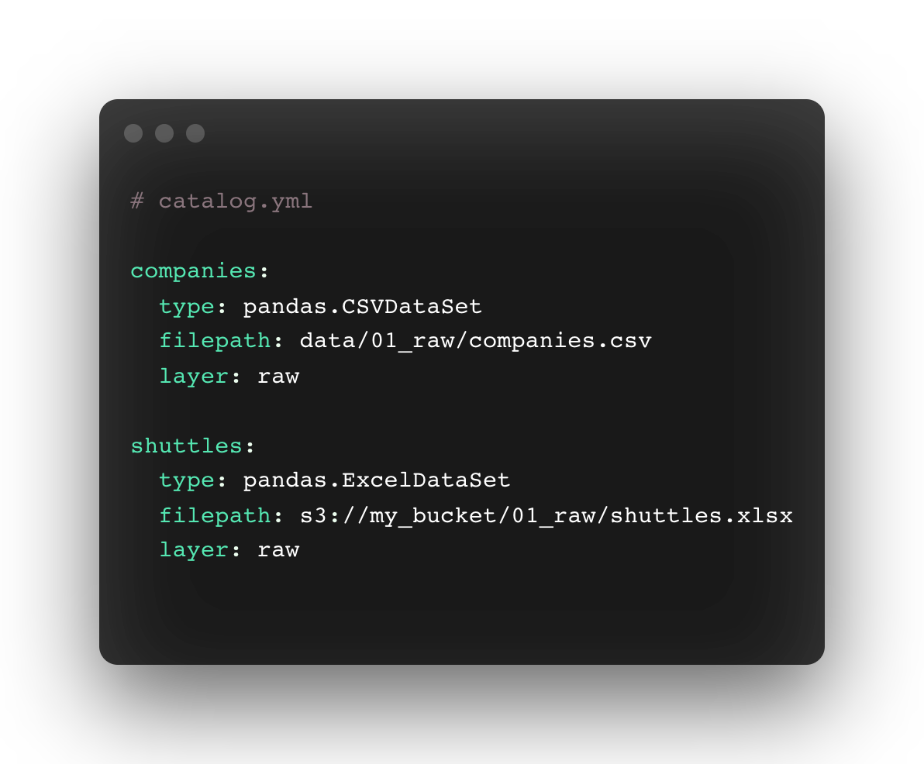
Adding entries to the Catalog
Declaratively describe your data with zero hard-coding
Notes:
Nodes don't do IO - standardise through catalog
Under the hood will call pd.read_csv and can pass in args in yaml file

Slide 20
Adding entries to the Catalog
Declaratively describe your data with zero hard-coding

Slide 21
Adding entries to the Catalog
Declaratively describe your data with zero hard-coding
Separation of concerns – business logic & config
Kedro uses fsspec behind the scenes
Supports S3 / GCP / Azure / sFTP / dbfs as well as local filesystems
Kedro ships with lots of handy connectors such as Spark, Dask Geopandas, NetworkX, Pickle, Plotly, Matplotlib and many more!
Notes:
No need to worry about boto or how to access Google cloud
Can write your own custom dataset
Gives consistent interface for many different formats

Slide 22

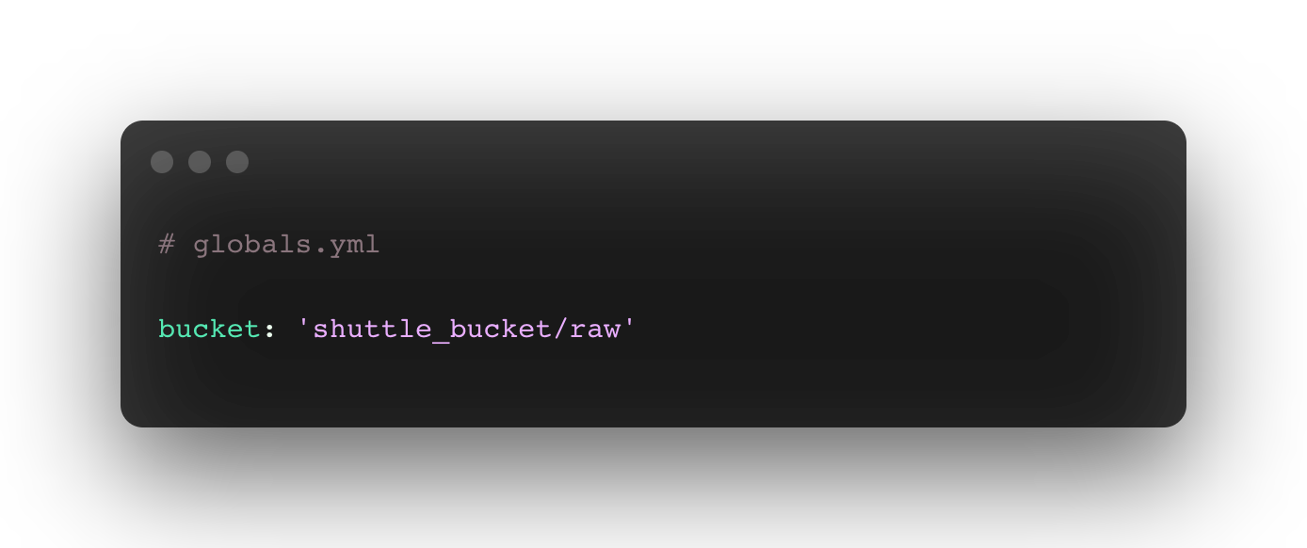
Adding entries to the Catalog
Catalog entries can be templated to avoid repetition
* Jinja2 supported as well
Notes:
Lots of yaml
Can simplify by splitting into multiple files
Templating to inject environment variables

Slide 23
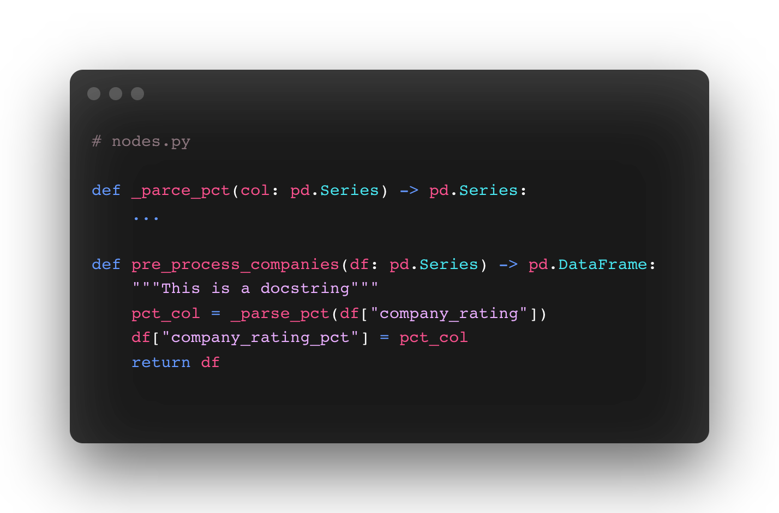
Defining a node
Nodes are the building blocks of pipelines and represent tasks
This is a pure Python function
It has no responsibility for loading or saving the data
Writing unit-tests for this function is straightforward

Slide 24
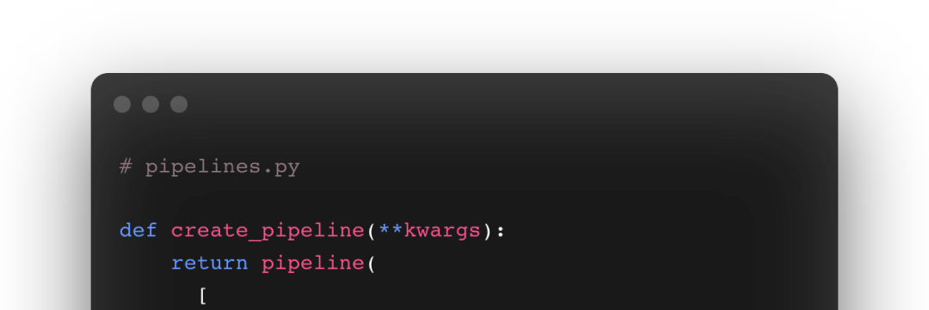


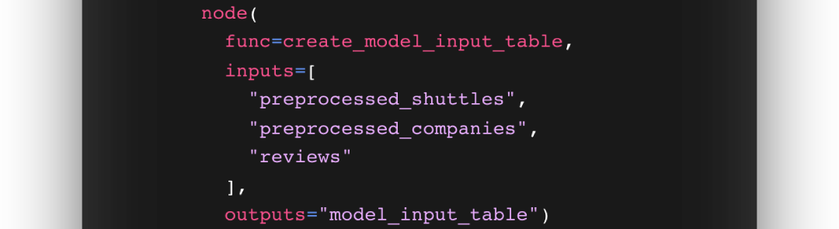

Defining a pipeline
Build your data-centric workflow
Notes:
Pipeline is defined from nodes that make it up
Datasets that tie pipeline together

Slide 25
Defining a pipeline
Simply put, a pipeline is a collection of nodes
Notes:
Inputs and outputs refer to names of datasets in data catalog

Slide 26
Defining a pipeline
Each node takes a callable, input(s) and output(s)

Slide 27
Defining a pipeline
Multiple inputs/outputs map positionally to the callable
(provide a dictionary to map keyword arguments)
Notes:
Can have multiple inputs/outputs (or no inputs or no outputs)
So create_model_input_table function signature has 3 arguments, one output

Slide 28
Defining a pipeline
Functions bound to nodes are highlighted with the icon
Notes:
In kedro viz

Slide 29
Defining a pipeline
Data dependencies are highlighted with the icon
Notes:
In kedro viz

Slide 30
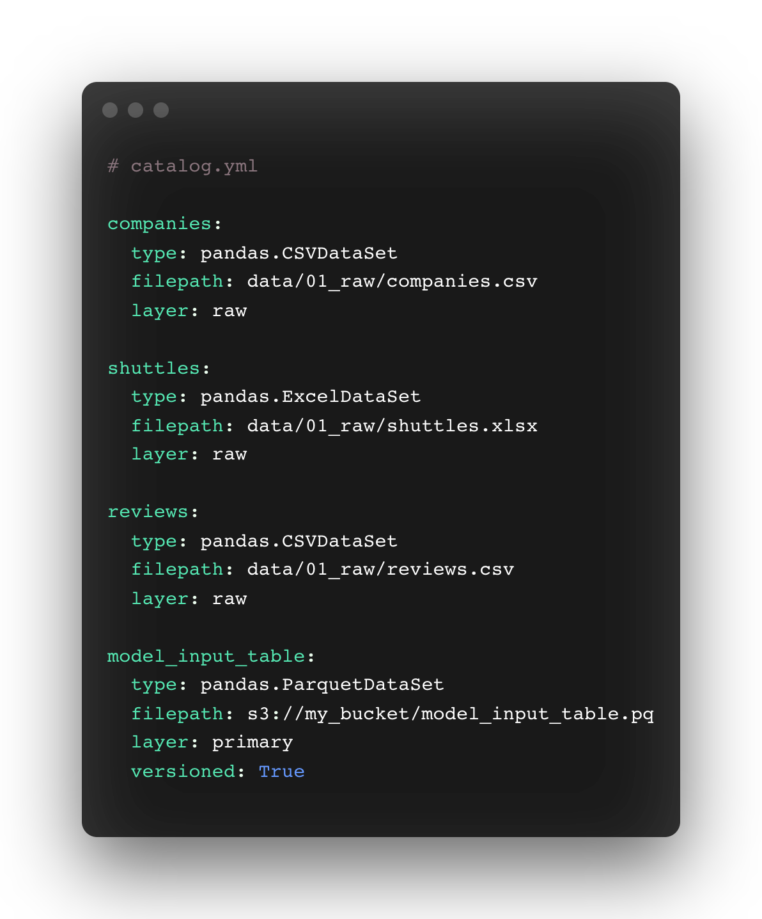
Catalog entries are persisted
MemoryDataSets are ephemeral and only exist at run-time
Notes:
Different from orchestrators and other tools

Slide 31
Catalog entries are persisted
MemoryDataSets are ephemeral and only exist at run-time
Notes:
These 4 persisted, written to disk

Slide 32
Catalog entries are persisted
MemoryDataSets are ephemeral and only exist at run-time
Notes:
These two are just kept in memory

Slide 33
Pipeline execution
Kedro derives the execution path from data flow
==
Notes:
Structure of DAG worked out using DATASET dependencies

Slide 34
Pipeline execution
Kedro derives the execution path from data flow
==

Slide 35



Are you ready for space travel with ?
👩‍🚀 Take a giant leap on into the spaceflights tutorial on kedro.readthedocs.io 🚀
Notes:
Reminder to use Slido for questions

